Slide 1

Mental Health and Wellbeing
Information, Local services, and Online Resources for Children, Young People, and Parent / Carers

Slide 2

Contents
The thresholds of support
Mental Health and Wellbeing services by locality
Helpful online resources for young people
Support for Parents / Carers
Aimed Support for Specific needs

Slide 3
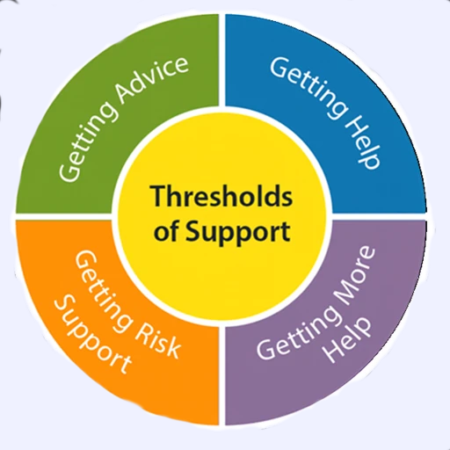
The different thresholds of support
This model outlines the various levels of support that young people may require to promote their mental health and wellbeing. It serves as a guide for identifying appropriate outreach and support interventions at each threshold.

Slide 4

Within the “Getting Advice” grouping are children and young people who need advice and signposting and self-management. This group includes both those with mild or temporary difficulties AND those with fluctuating or ongoing severe difficulties, who are managing their own health and not wanting goals-based specialist input.

Slide 5
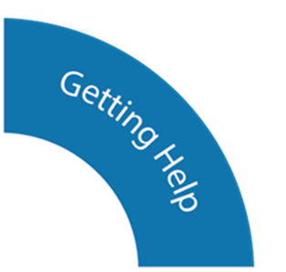
“Getting Help” comprises those who need specific interventions focused on agreed mental health outcomes. An intervention is any form of help related to a mental health need in which a paid-for professional takes responsibility for input directly with a specified individual or group.

Slide 6

In the “Getting More Help” group are those who need more extensive and specialized goals-based help with their mental health. This grouping might include children with a range of overlapping needs that mean they may require greater input, such as the coexistence of major trauma or broken attachments.

Slide 7

“Getting Risk Support” is for those who have not benefitted from or are unable to use help, but are of such a risk that they are still in contact with services. This group might include children and young people who routinely go into crisis but are not able to make use of help offered, or where help offered has not been able to make a difference; who self-harm; or who have emerging personality disorders or ongoing issues that have not yet responded to interventions.

Slide 8
Local Services
Mental Health and Wellbeing services for young people are usually allocated according to their registered GP address, rather than their local authority or school
The following slides provide information on the services available to Dovecote pupils in their local areas

Slide 9



Somerset
Getting Advice, Getting Help:
Young Somerset- Low-Intensity Cognitive Behavioural Therapy for mild-to-moderate mental health disorders via Children’s Wellbeing Practitioners. Targeted Youth Support - supporting children and young people who have high levels of need, risk and vulnerability
Open access youth clubs, and projects such as Young Rangers – scheme for young people aged 12-16 based around the Quantock Hills, learning practical skills, teamwork
All free for young people to access, self-refer online:
wellbeing@youngsomerset.org.uk https://www.youngsomerset.org.uk/
REACH- Offer a variety of professional services to schools, including support, interventions, and general services to students. This can take place in one to one and group settings. Also offers youth groups for young people and Family support events.
info@reachyouth.co.uk http://www.reachyouth.co.uk/
Mind in Somerset- Peer support and community groups. (Details can be found on their website under their our services tab). Mind in Somerset
They also offer an anonymous call line called Mindline Trans + for anyone seeking verbal support around LGBTQ + support number : 0300 330 5468

Slide 10

Somerset
Getting More Help, Getting Risk Support:
It is advisable to seek advice from young person’s GP in the first instance for young people in this group
CAMHS Single Point of Access (SPA)
Before referral you are required to gain the consent and agreement of the young person and their parent/carer
Referral form can be found online (downloadable on their home page): https://www.somersetft.nhs.uk/camhs/
Young people aged 16 - 17 can self-refer, via online form: https://www.somersetft.nhs.uk/camhs/spa/self-referral/ or contacting the team: 03001245012

Slide 11

Bristol, South Gloucestershire, & North Somerset
Getting Advice, Getting Help:
Off the Record
A wide range of one-to-one therapies for 11-17 year olds, including talking therapies and music therapy
Drop in Hubs for all young people aged 11-25
Resilience Lab workshops
Projects including Art Works, Nature Works, and OTR Sounds, and Book club
Freedom – a gender and sexuality youth group with specialist 1:1 support
All free to access, self refer online: https://www.otrbristol.org.uk/
Vitaminds
Free to access CBT for young people aged 16+ NHS Talking Therapies - North Somerset & South Gloucestershire (vitahealthgroup.co.uk)
Creative Youth Network
A range of projects, free to access, self refer online https://www.creativeyouthnetwork.org.uk/

Slide 12
Bristol, South Gloucestershire, & North Somerset
Getting More Help, Getting Risk Support:
It is advisable to seek advice from young person’s GP in the first instance for young people in this group
CAMHS
Referral in writing using Single Point of Entry form
Currently only accepting referrals from certain professional groups (GPs, schools, social workers etc)
https://www.awp.nhs.uk/camhs/professionals
CAMHS Autism Intensive Service
Offering intensive programmes for children and their families, and PBS consultation to professionals
Referral through locality CAMHS service
Website for more info is : Autism intensive service :: Avon and Wiltshire Mental Health Partnership NHS Trust

Slide 13


Bath, North East Somerset, Swindon, & Wiltshire
Getting Advice, Getting Help:
Off the Record
A wide range of one-to-one therapies for 11-17 year olds, including talking therapies and music therapy
Drop in Hubs for all young people aged 11-25
Projects including Wellbeing Walks, Mind Aid, and The Resilience Lab
All free to access, self refer online: https://otrnorthsomerset.org.uk/
Youth Connect South West
Free targeted support for children and young people, including 1:1 support and Youth Clubs
General website: https://www.youthconnectsouthwest.org.uk/
Self refer online: https://form.jotform.com/YCSW/targeted-support-referral

Slide 14
Bath, North East Somerset, Swindon, & Wiltshire
Getting More Help, Getting Risk Support:
It is advisable to seek advice from young person’s GP in the first instance for young people in this group
CAMHS
Referrals from professionals and self-referral using online form https://www.oxfordhealth.nhs.uk/camhs/support/referral/
Mental Health Helpline
Call the urgent mental health helpline on 0800 023 2133.
Open 5.00pm to 11.00pm on weekdays, 9.00am to 11.00pm Saturday, Sunday and Bank Holidays.

Slide 15

Mental Health and Wellbeing Online Resources
For all Children and Young People, regardless of locality

Slide 16
Immediate Mental Health support
If emergency, call 999 or go directly to A&E
Mindline Somerset: 24/7 Emotional Support & Mental Health Helpline: 01823 276892
Samaritans: for everyone, (24/7): 116 123
Childline: for children and young people under 19 (24/7): 0800 1111
Papyrus: for people under 35. Call: 0800 068 41 41 – Monday to Friday 10am to 10pm, weekends 2pm to 10pm, bank holidays 2pm to 5pm

Slide 17





Websites
Get Self Help: provides CBT self help and therapy resources, including worksheets and information sheets and self help mp3s https://www.getselfhelp.co.uk/
National Autistic Society: find advice and support on all aspects of life with autism. https://www.autism.org.uk/
Kooth: an online community of peers and a team of experienced, accredited counsellors https://www.kooth.com/
YoungMinds: the UK’s leading charity committed to improving the emotional wellbeing and mental health of children and young people. https://www.youngminds.org.uk/
We engage with people affected by eating disorders, including those supporting a person with an eating disorder, by offering hope and enabling access to support services that empower recovery.
https://swedauk.org/

Slide 18







Apps
SAM: Free self-help app for Anxiety Management
Whats Up?: Free app using CBT and ACT methods to help you cope with Depression, Anxiety, Anger, Stress and more.
Headspace: Mediation to help improve your focus, exercise mindful awareness, relieve anxiety and reduce stress.
Mindshift: Free app to help cope with everyday anxieties.
Daylio Journal: Free app, Self-Care Bullet Journal with Goals Mood Diary & Happiness Tracker
CALM: A simple mindfulness meditation app, offering a free trial.
Tellmi: Free digital peer support app, demonstrated to improve mental health for young people aged 11-25.

Slide 19
Support for Parents/ Carers
Somerset Parent Carer Forum
Parent led organisation providing support for families with children 0 to 25 with additional needs or disabilities: https://somersetparentcarerforum.org.uk/
Somerset Kinship Team
Provide support for Special Guardians in Somerset. Help and advice line for Special Guardians, family members, or professionals, open Monday to Friday between the hours of 9:00 to 17:00.
If required can arrange to meet with Special Guardians to discuss their circumstances in more detail. Kinship Duty number: 01823 358222 or email: kinship@somerset.gov.uk
Finding Your Way
Somerset Parent Carer Forum CIC runs an online virtual support group for parents/ carers of children with Special Educational Needs and /or Disabilities (SEND): https://www.facebook.com/groups/FindingYourWay/
Contact
Free helpline for parents / carers in UK with a disabled child aged from birth to 25. Your child can have any kind of disability or additional need, and you do not need to have a diagnosis. Call on 0808 808 3555 9.30am-5pm, Monday-Friday, free from UK landlines and UK mobiles. Press 1, to speak to an education adviser, press 2 for all other helpline enquires.

Slide 20
Aimed Support for Specific needs
Somerset government website to find out about support for Young carers :Young Carers
Somerset Phoenix project Linked to Barnardo’s specifically provides support for young people who have been affected by sexual abuse: https://www.somersetphoenixproject.org.uk/
Trauma recovery uk specialists in Trauma Recovery, helping families recover from complex trauma. Based in Bath but covers somerset : https://survivorpathway.org.uk/services/trauma-recovery-uk/
Adoption west provides support for Adoptive families and children. Covering Bath and North-East Somerset, Bristol, Gloucestershire, North Somerset, South Gloucestershire and Wiltshire: Support - Adoption West
Adoption south-west provides the same but covering somerset: https://www.adoptsouthwest.org.uk/

Slide 21
Aimed Support for Specific needs
2BU is a service that provides 1:1 support, peer mentoring, Alternative provision and youth groups for young people aged 11-25 wanting to access LGBTQ+ support: 2BU Support services
Turning Point’s SDAS, this county-wide programme provides free, confidential support—including early intervention, education, guidance and full support for young people at any stage of substance use: Somerset Drug and Alcohol Service (SDAS) | Turning Point
A specialist free service in North-somerset for under-18s providing advice, info, education, treatment programmes, and harm reduction. Features self-referral; meets in schools, homes, or offices: Substance Advice Service | North Somerset Council

Slide 22
Aimed Support for Specific needs
Sweda is a regional charity supporting people affected by eating disorders across regions in the South & West of England SWEDA has grown to provide a range of services for people struggling with Anorexia Nervosa, Bulimia Nervosa, Binge Eating Disorder and more. Our services also give support to family members and friends engaged in the difficult task of supporting someone close to them. https://swedauk.org/about-us
Harmless and The Tomorrow Project are a user-led organisation providing a range of services about self harm and suicide including support, information, training and consultancy to people in need, their friends and families, and professionals. Suicide prevention and suicide bereavement services are delivered through our sister service The Tomorrow Project While not specific to Somerset, they offer widely accessible support and info throughout the uk: https://harmless.org.uk/
Somerset Mind line offers 24 phone advise and support if worried about a child’s mental health/ self-harming/ Suicidal ideation. ideation:0800 138 1692 or 01823 276 892

